Slide 1

British Airways
Customer Behaviour Prediction

Slide 2
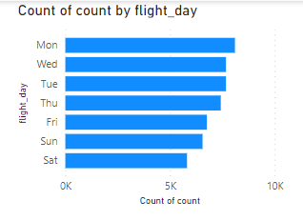
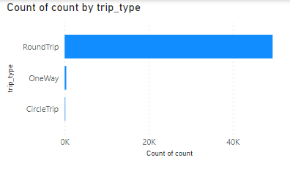
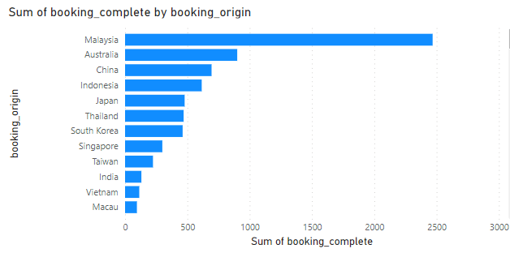
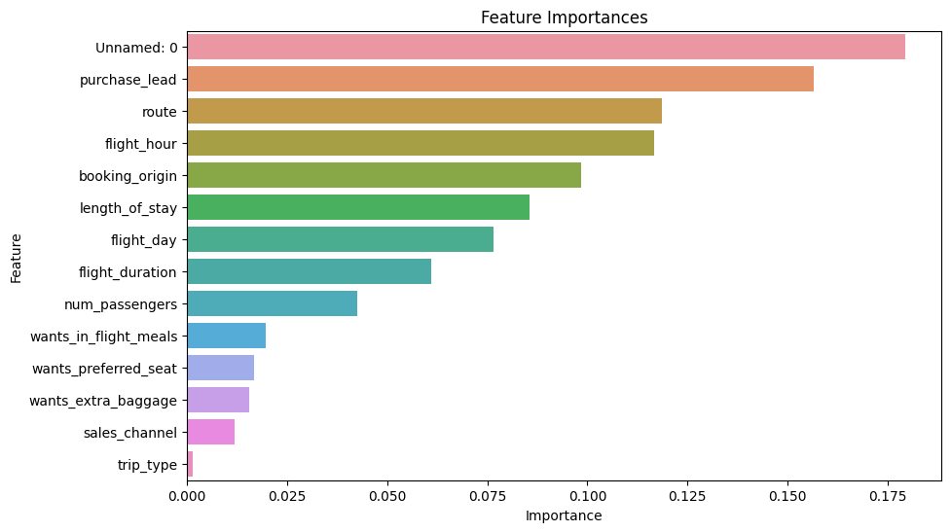
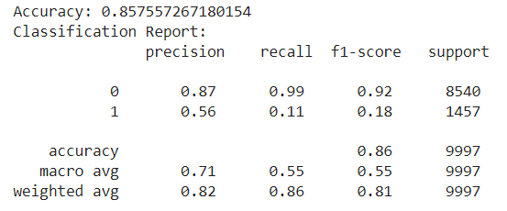
KEY INSIGHTS
Most number of flights bookings have been done from the customers of Malaysia, followed by Australia and China
Customers have booked more flights on Mondays and least lights on Saturdays.
Customers have booked Roundtrips more instead of One way trip
Model Evaluation:
Accuracy = 86%
Precision = 0.87 (0 – unlikely to make a booking) and 0.56 (1 – likely to make a booking)
Recall = 0.99 (0 - correctly identified 99% of the instances that were actually not making a booking) and 0.11 (1 - identified only 11% of the instances that were actually making a booking.)
Feature Importance:
Purchase lead is the most important feature for this predictive modelling. Purchase lead represents the number of days in advance a customer made a purchase or booking for a flight. British airlines should use this information to understand customer booking behavior and plan their services and marketing accordingly.

